Slide 1
Being Sent!

Slide 2
Outline
1) What does it mean to be sent?
2) Where are we sent today?
3) How are we sent?
4) Things to think about

Slide 3
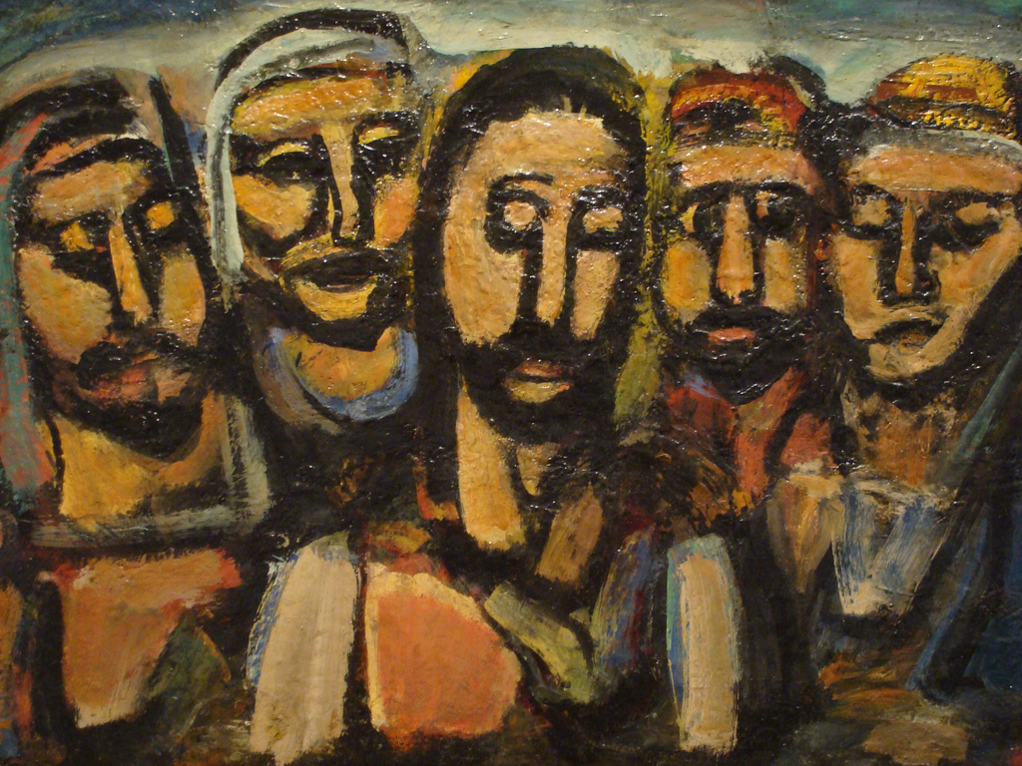
1) Being Sent – What does it mean?
For All Christians

Slide 9
“Whenever we take a step toward Jesus, we come to realize that he is already there, waiting for us with open arms”
(Evangelii Gaudium, 3)

Slide 10
2) Where are we sent today?
Polarization

Slide 11
Being Prophetic
... "bold and creative," open to change and to move away from doing things "as we have always done" (EG, 32-33).

Slide 12
3) How are we sent?
"'You will be my witnesses to the ends of the world' (Acts 1:8). These are among Jesus' last words to his apostles after the resurrection. He probably had talked to them about the coming of the Holy Spirit and now he was making clear that the Holy Spirit was not going to come to perform a spectacular change but to transform them, the apostles, so that they could be his witnesses, by bringing the Risen Lord to the farthest ends of the earth.” (Chiara Lubich, 1/2/1986)

Slide 13
Speaking...
"We always say that in order to love we need to make ourselves one with our neighbors in everything except sin. This is good. But I wouldn't want for this to become for us an excuse to avoid the risk of speaking up. We have to be careful not to confuse true and false prudence and remain in despicable silence” (Chiara Lubich, June 1993)

Slide 14
4) Something to Think About
Resistance

Slide 15
Fear of Change

Slide 16
Fatigue
"Let's ask ourselves, is the apostolic drive, the desire to proclaim the Gospel still alive in me? And are the values of communion, dialogue, fraternity, the desire to bear witness to the grace of the Risen Lord among us, still alive within me?" (Margaret Karram)

Slide 17
Stages of Life

